Slide 1

Prof. V. B. Shah Institute Of Management & R. V. Patel College Of Commerce (Eng. Med.) &
V. L. Shah College Of Commerce (Guj. Med.) &
Sutex Bank College Of Computer Application & Science
(Accredited ‘B’ (CGPA 2.55) by NAAC Dec.-2009)
VEER NARMAD SOUTH GUJARAT UNIVERSITY, SURAT
AIRSTRO
GUIDED BY:
Asst. Prof. Twinkle Panchal
SUBMITTED BY:
647 – Nishil Chavda
658 – Deep Sorathiya
678 – Rahul Gadhiya

Slide 2

OVERVIEW
Project Profile
Project Overview
Admin/ User Features
Diagrams
Data Dictionary
Screenshots
Conclusion

Slide 3
Project Title | Airstro
Frontend | HTML, CSS
Backend | PHP
Database | MySQL
Browser | Chrome, Firefox, Safari
Platform | VS Code, Xampp
Internal Guide | Prof. Twinkle S. Panchal
Submitted To | Prof. Twinkle S. Panchal

Slide 4
PROJECT OVERVIEW
The Airstro – A Next-Generation Flight Booking & Travel Experience Platform. Airstro is designed to streamline the experience of flight search, booking, and travel management for both users and administrators by providing an easy-to-use and visually appealing platform.
The system is fully responsive, mobile-friendly, and features a modern professional UI for improved usability.
The Airstro consists of two major panels:
Admin Panel
User Panel

Slide 5
PROBLEM STATEMENT
In traditional flight booking, passengers often need to visit travel agencies or airline counters physically to check flight availability and purchase tickets. This process is time-consuming, inconvenient, and lacks transparency in pricing and schedule updates. Manual management of flight schedules makes it difficult for administrators to update flight information, which may lead to booking errors and miscommunication. Users cannot easily track their booking history or cancel tickets without lengthy procedures. There is no centralized system to manage flight details, user records, and booking data, which may result in data duplication, loss, or mismanagement. To overcome these issues, we developed a digital Online Flight Booking System – Airstro.

Slide 6
ADMIN FEATURES
Admin Panel
Login is required using admin email and password.
Admin can add new flights, update flight details, or delete flights.
Admin can view all flights available in the system.
Admin can view all user bookings along with passenger details.
Admin can update booking status or delete bookings if necessary.
Admin dashboard provides a centralized flight & booking management interface.

Slide 7
USER FEATURES
User Panel
Users can Register/Login using email and password for authentication.
Main navigation includes: Home, Deals & Offers, My Trips, About Us, Login, Signup
Home Page displays Hero section, booking widget, offers, and recommended destinations.
About Page describes Airstro’s mission and international network along with loyalty benefits.
Users can select a flight and complete the booking instantly.
My Trips Page displays:
All booked flights
Total fare
Booking status
Users can cancel flights anytime
Users cannot book or manage flights without logging in.

Slide 8
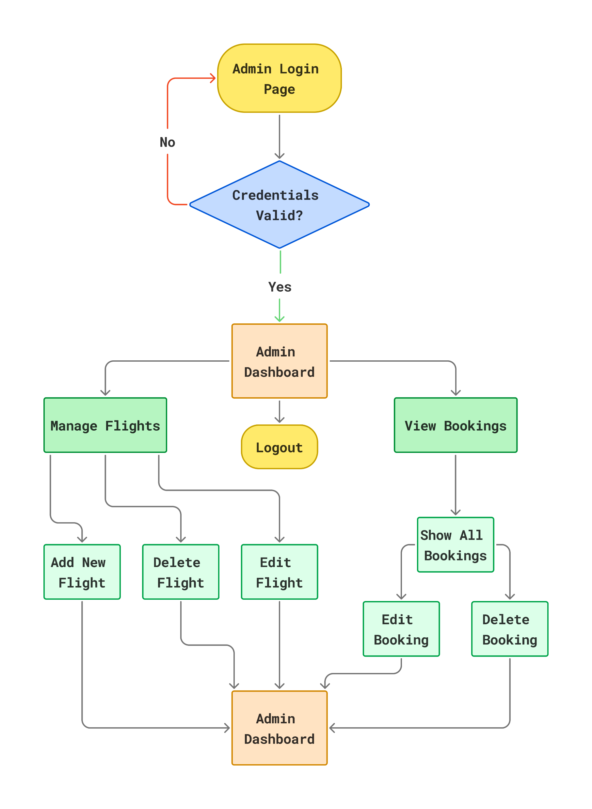
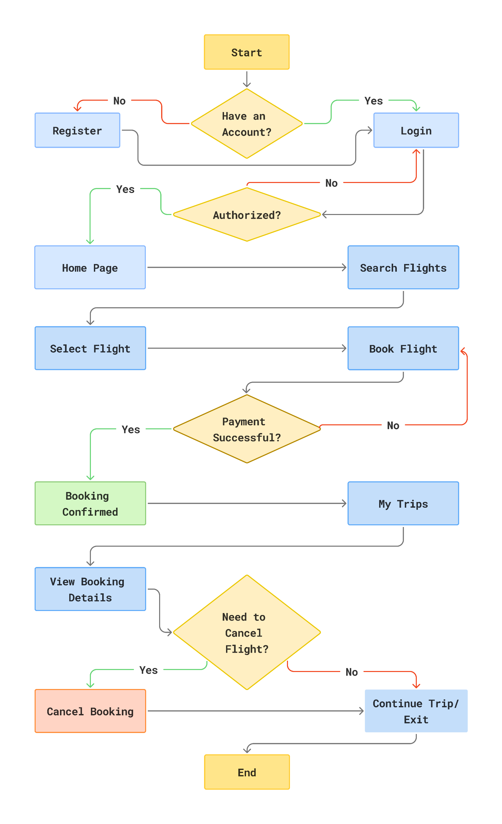
Admin/User Process Flow Diagram

Slide 9
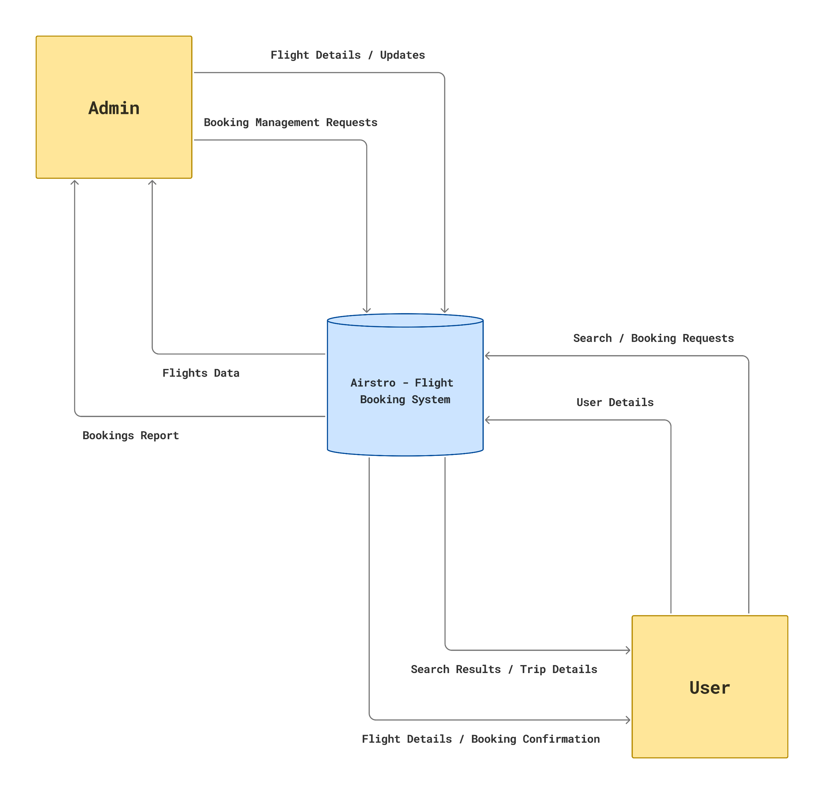
0 Level Diagram (Context Diagram)

Slide 10
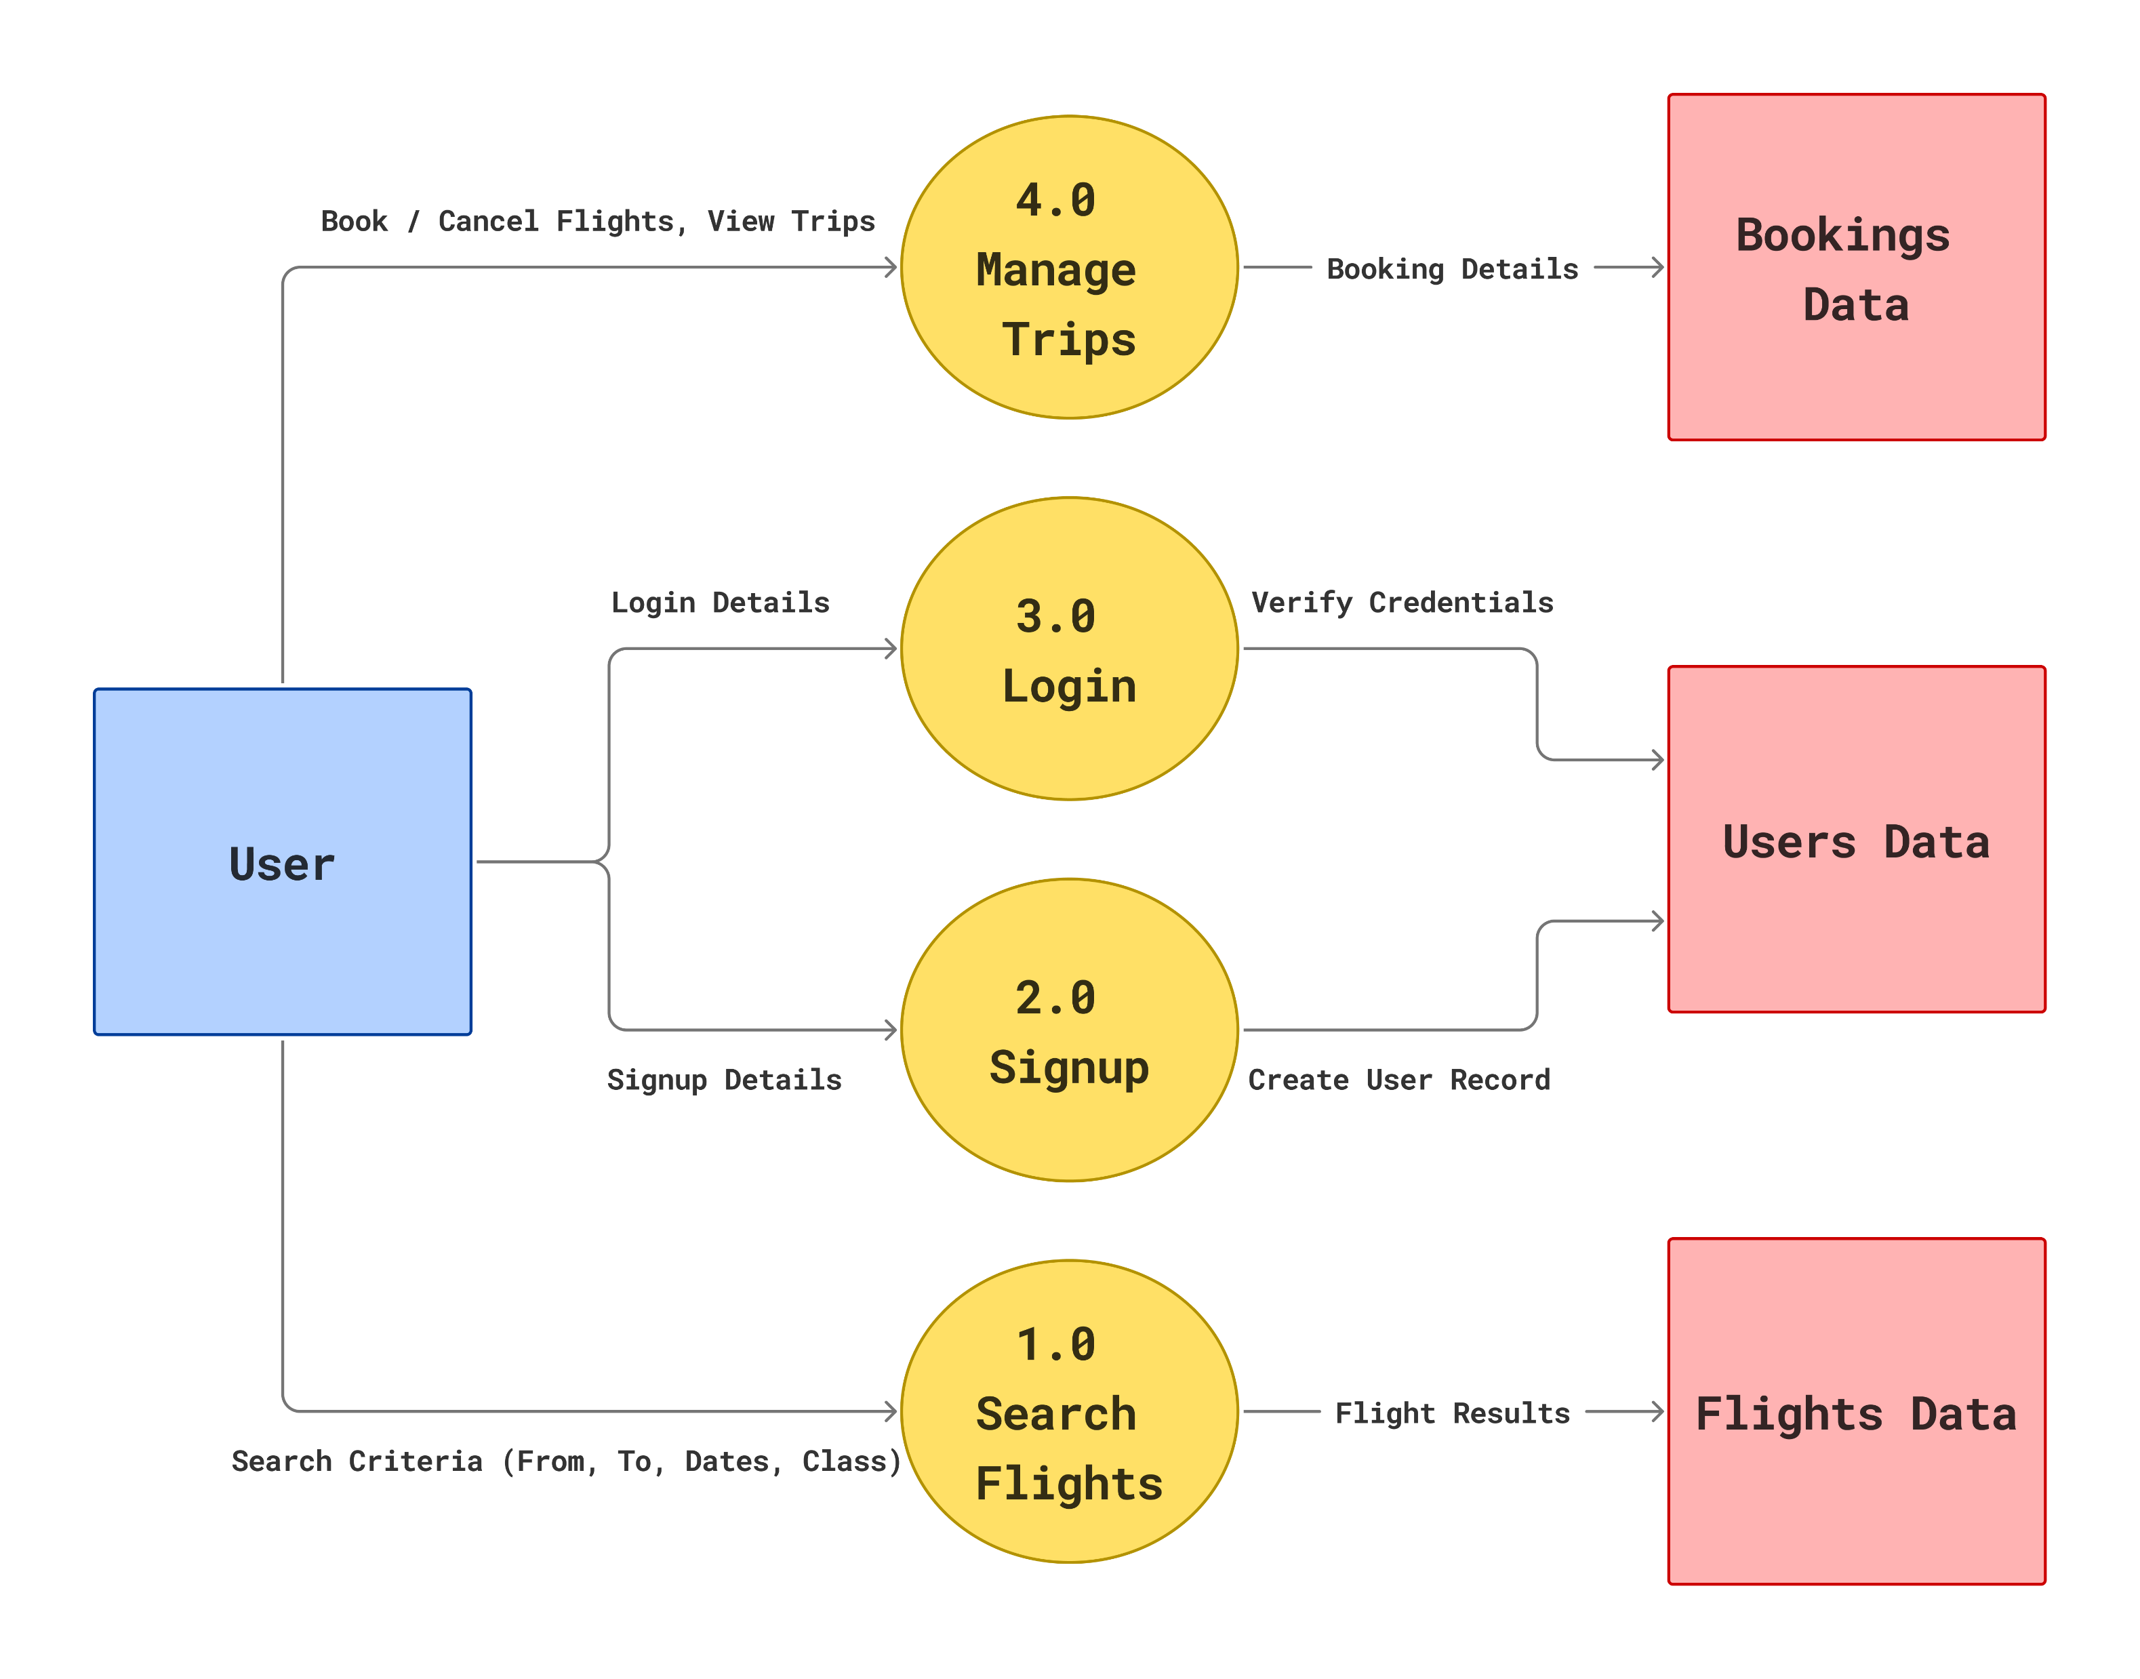
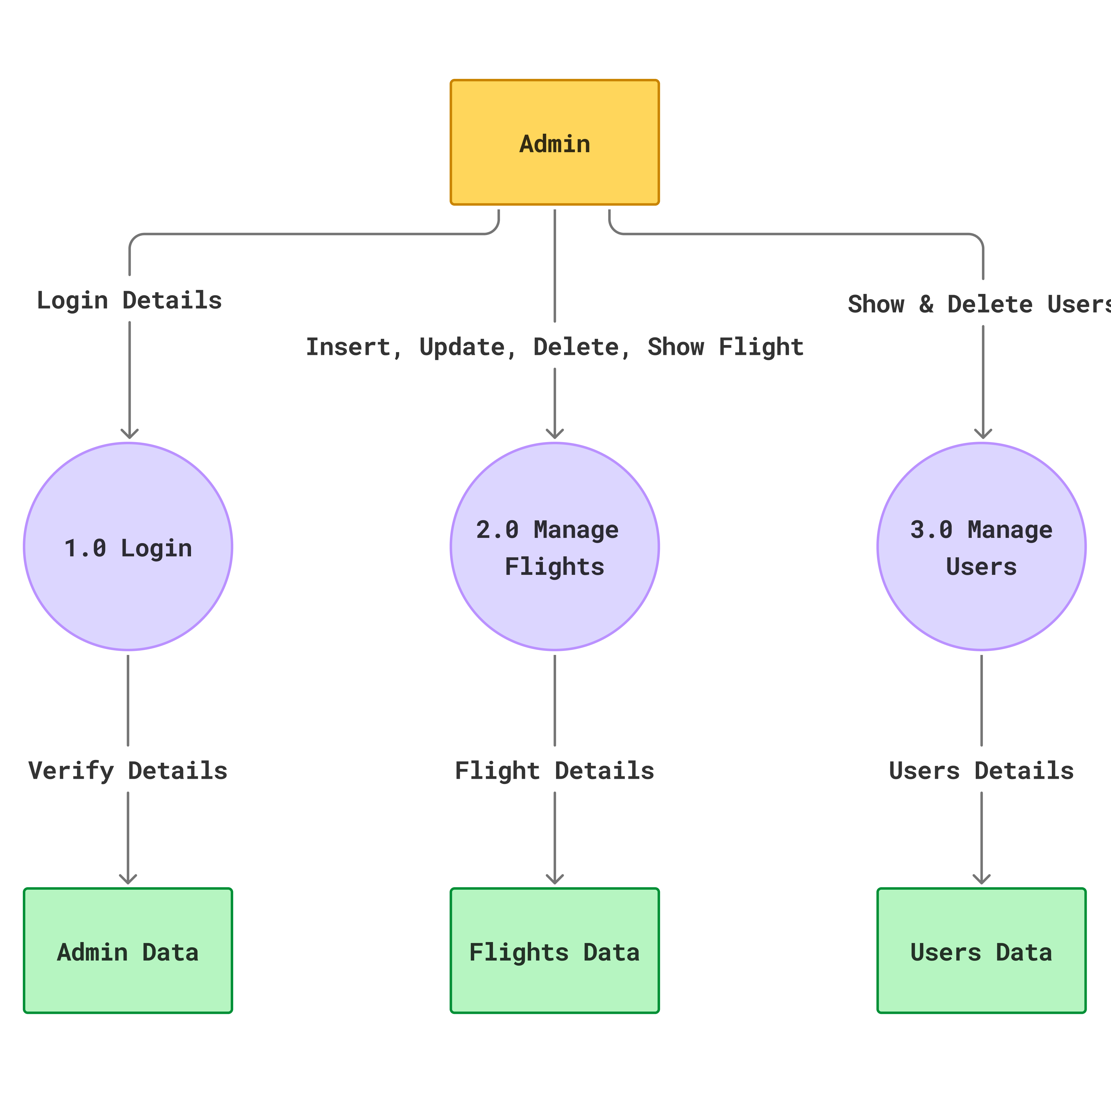
1 Level Admin/User Diagram

Slide 11
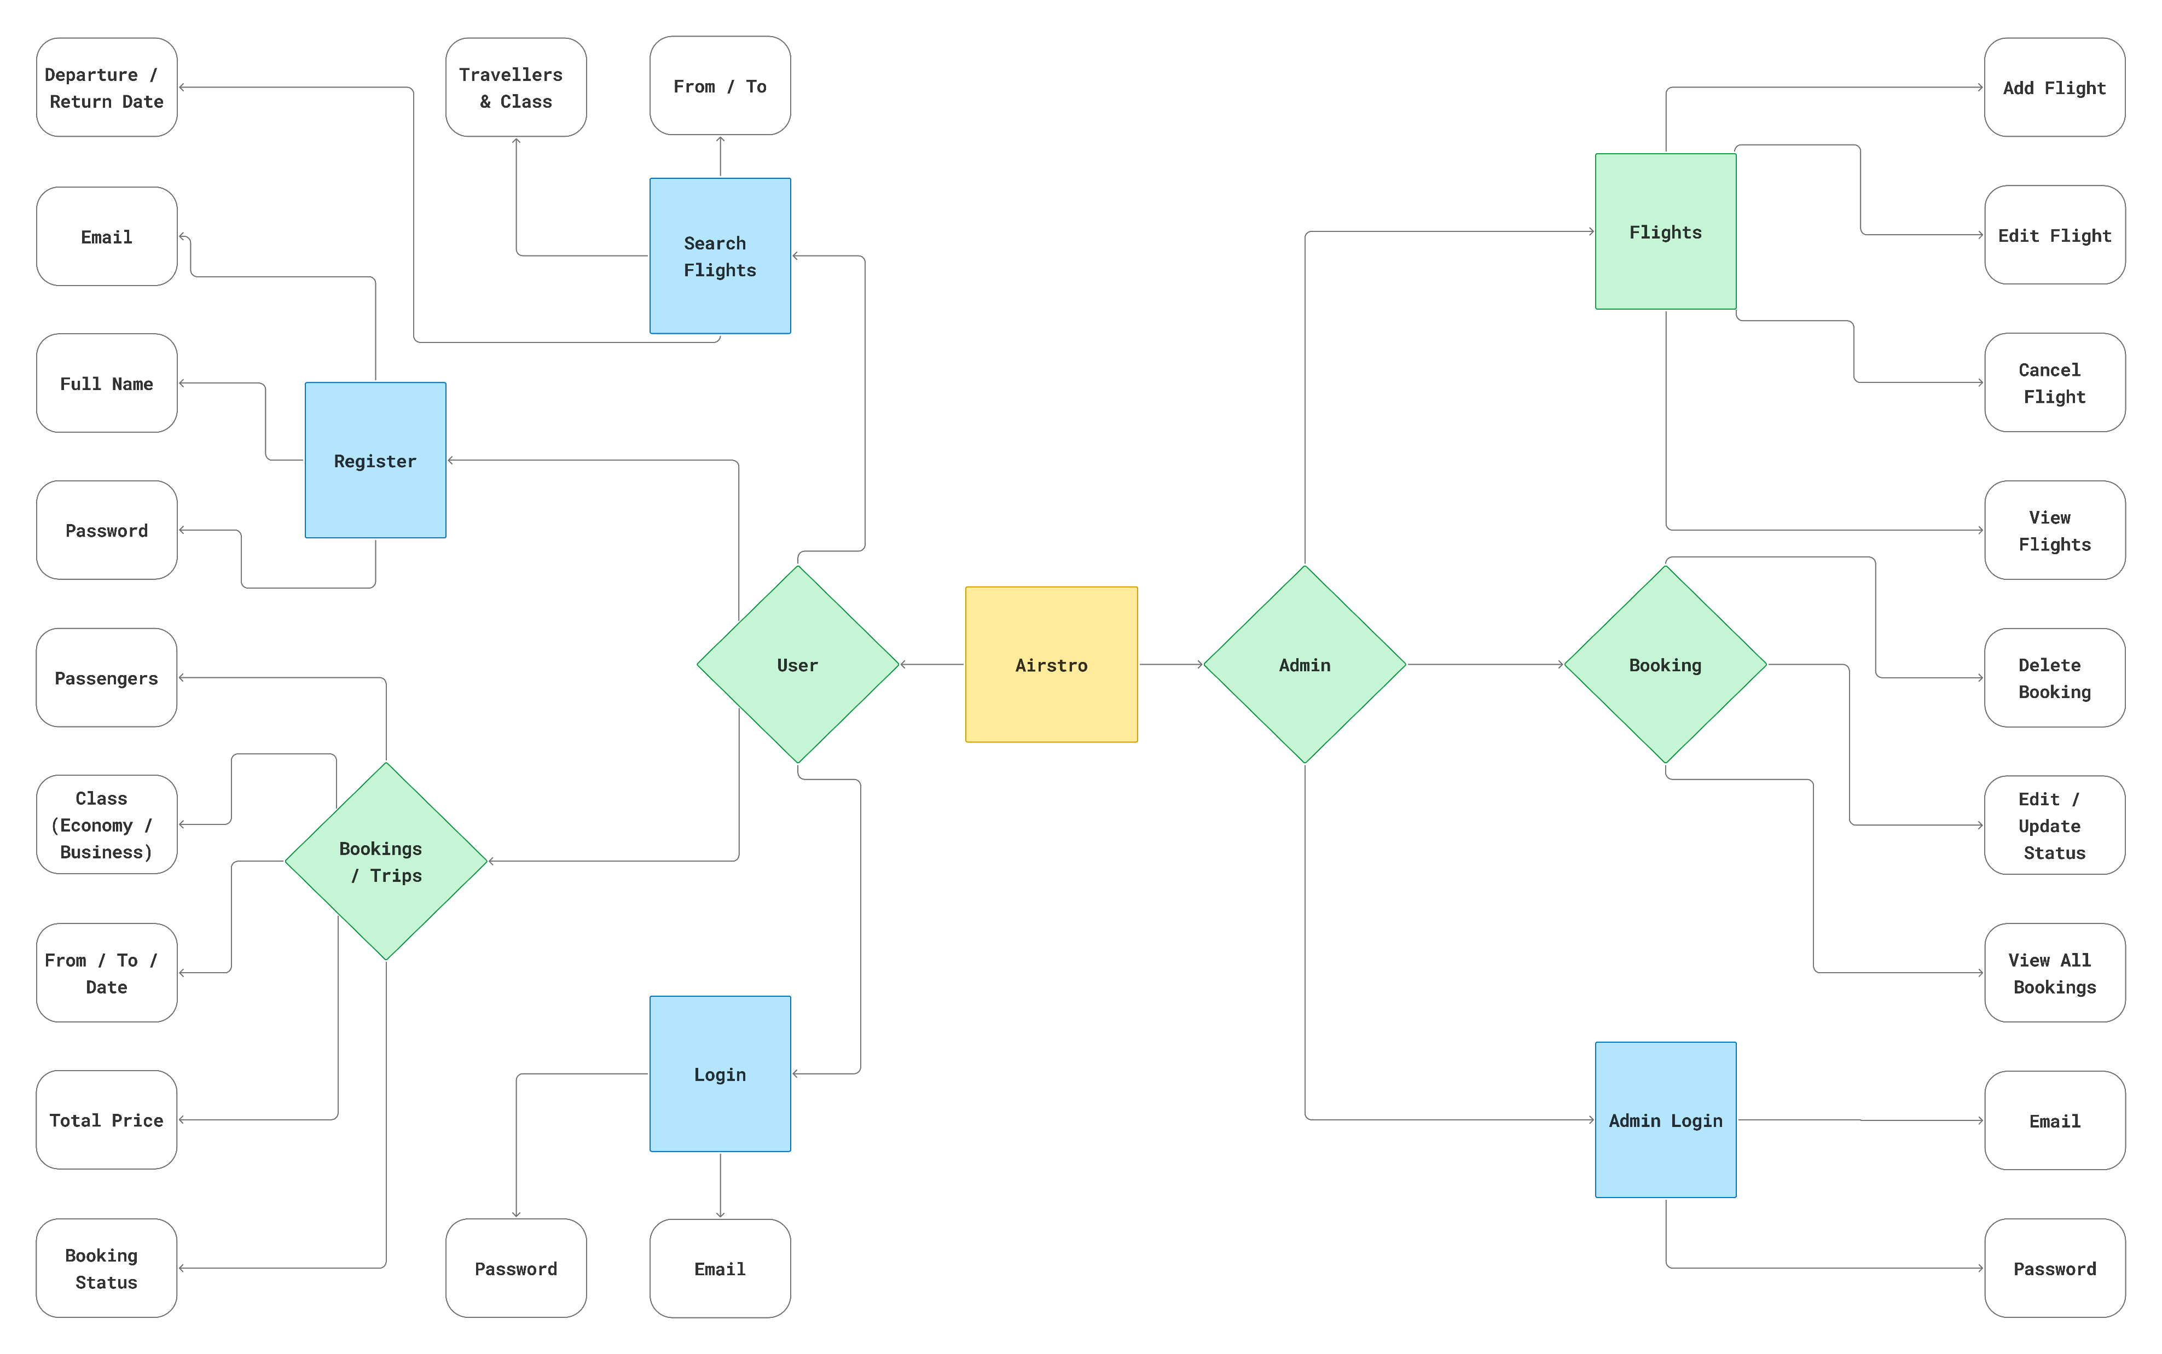
ER Diagram

Slide 12

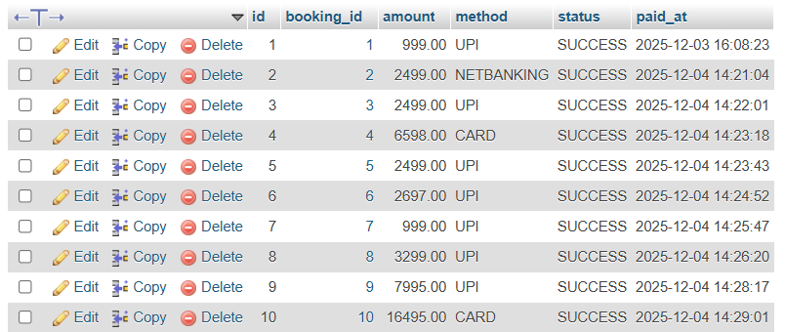
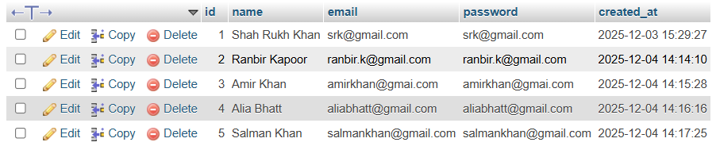
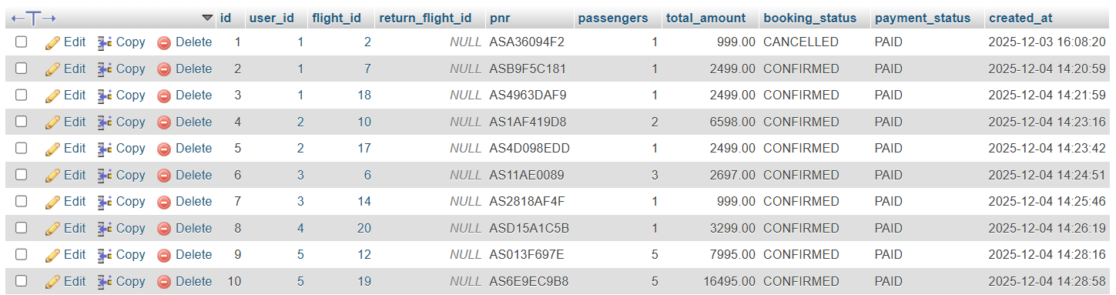
DATABASE DESIGN
Admin Table
Payment Table
User Table
Bookings Table

Slide 13
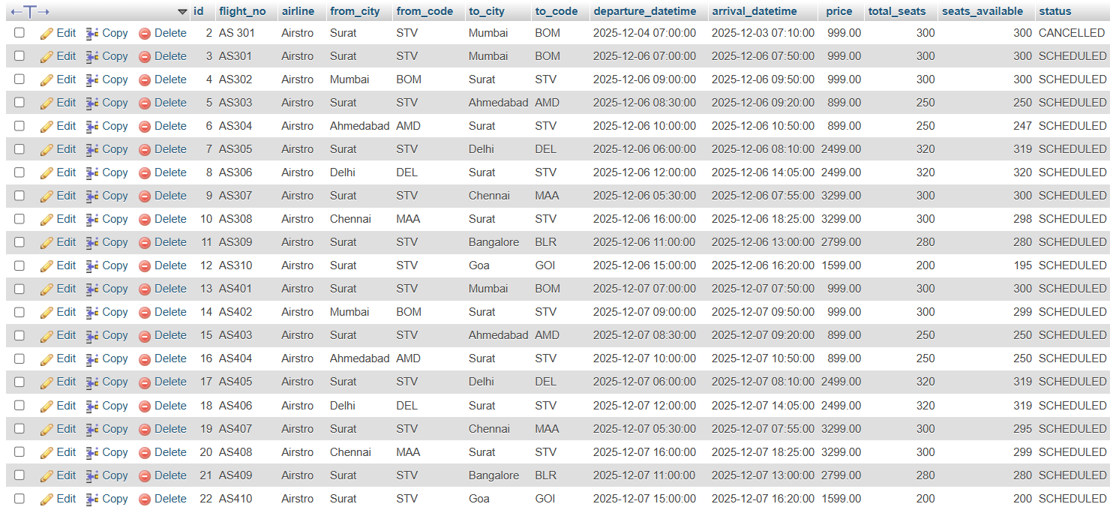
DATABASE DESIGN
Flight Table

Slide 14
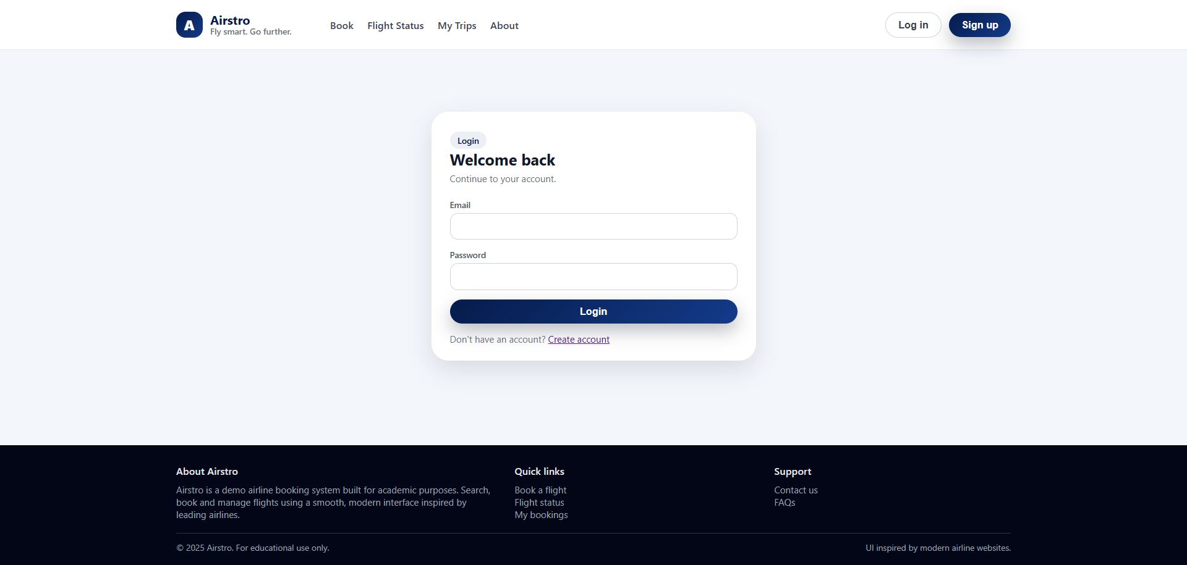
Admin Login

Slide 15
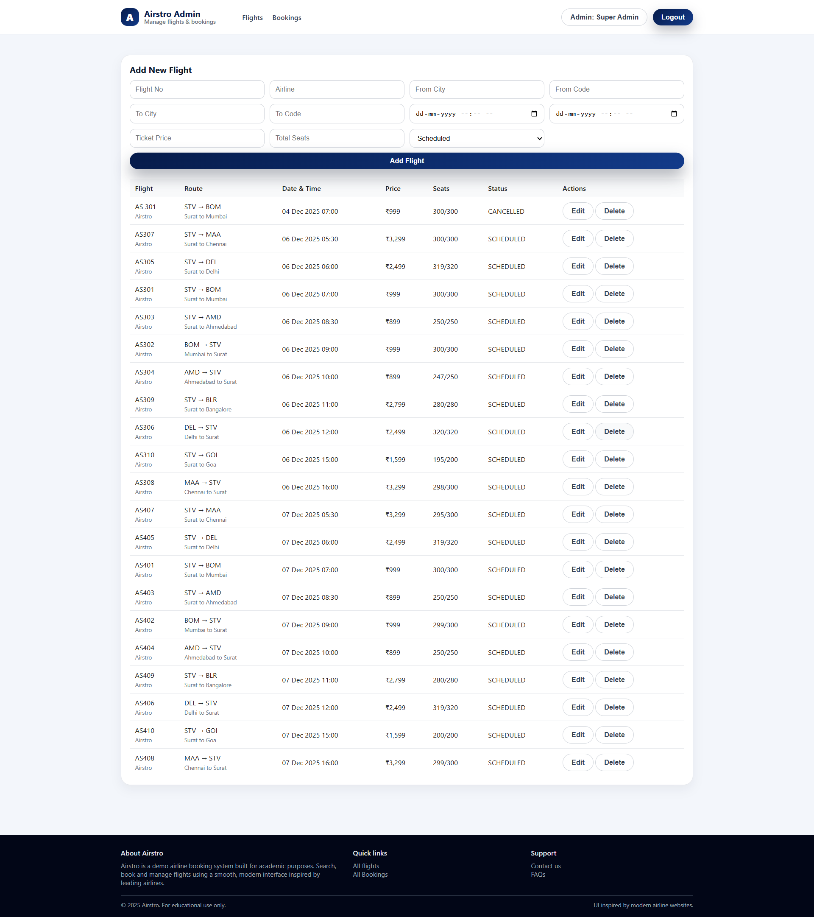
Admin Dashboard

Slide 16
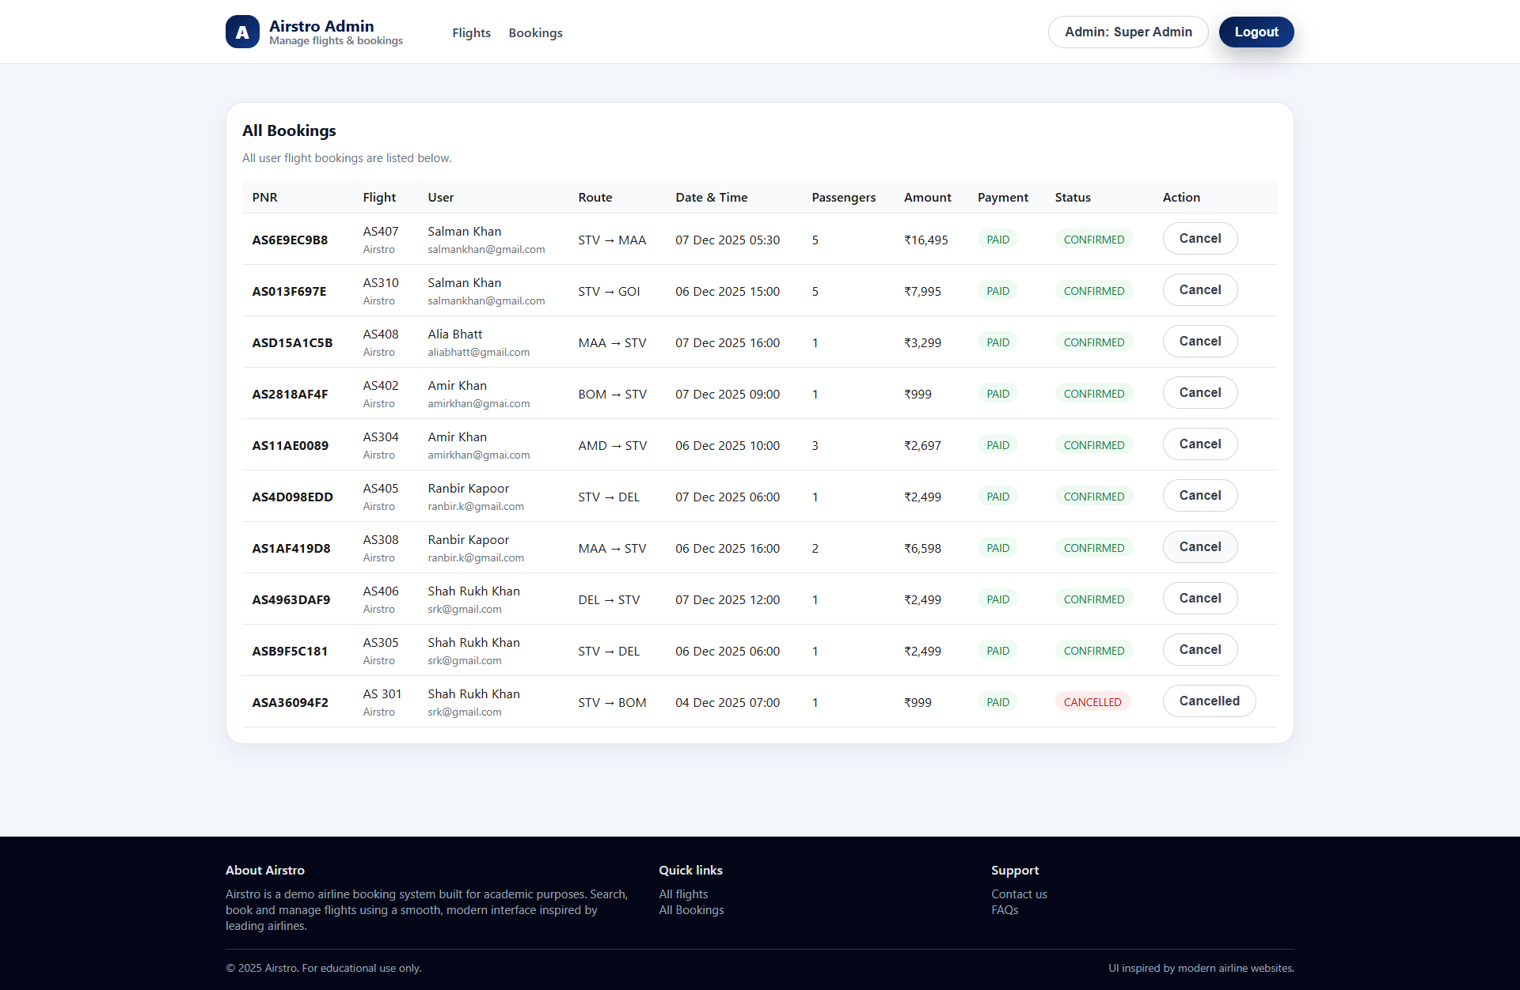
Admin Dashboard

Slide 17
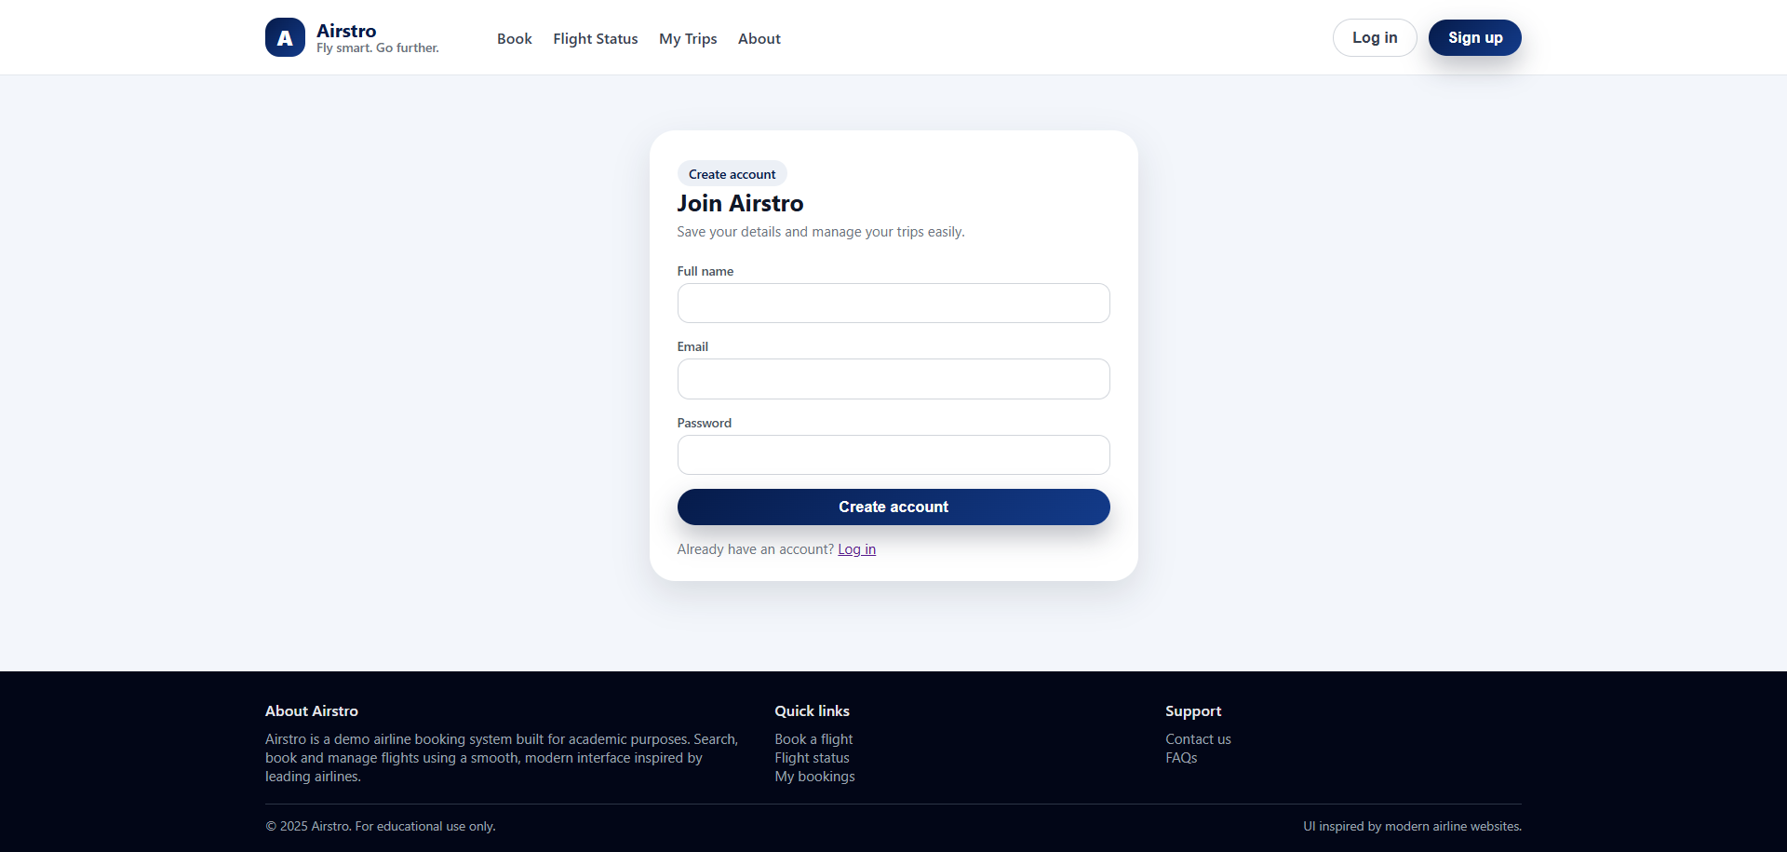
User Sign Up

Slide 18
Admin Login

Slide 19

Home Page

Slide 20
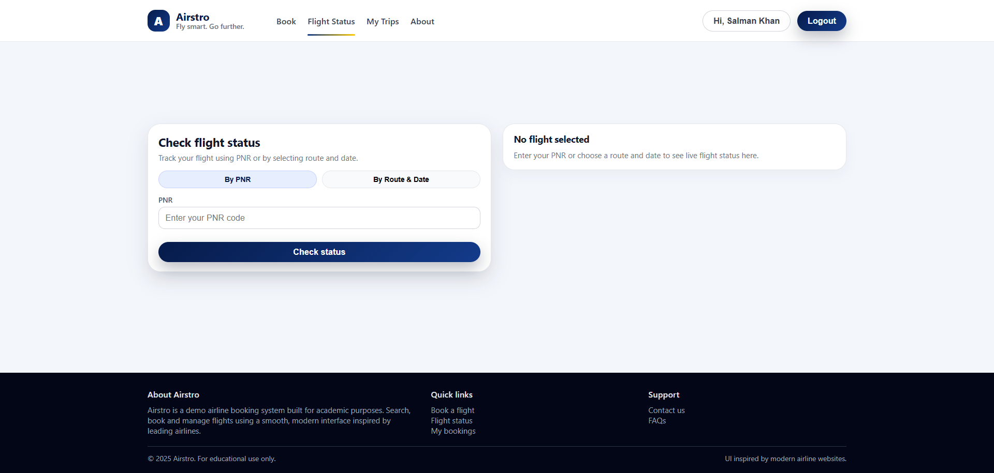
Flight Status

Slide 21
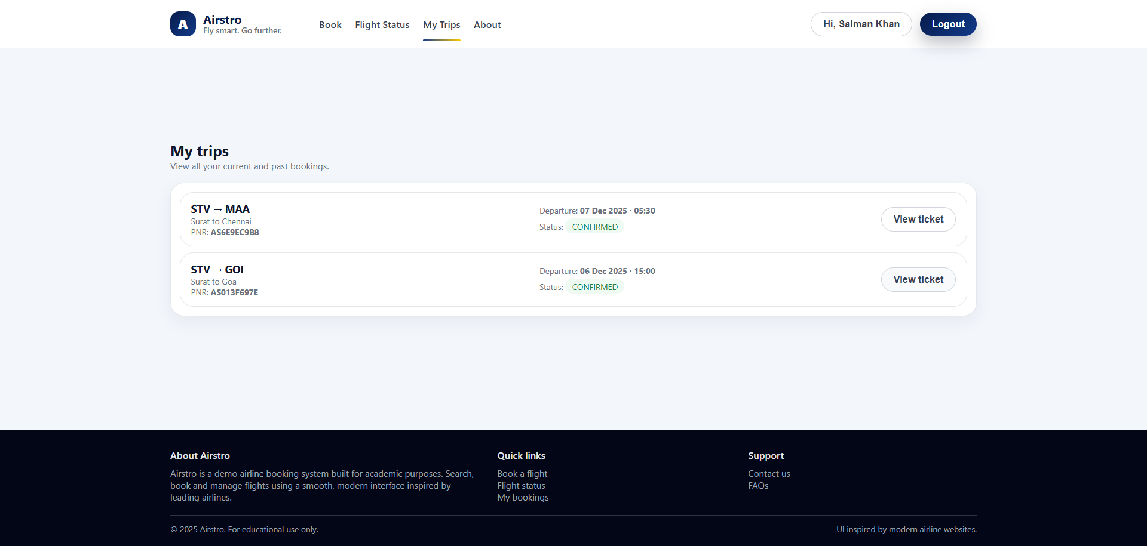
My Trips

Slide 22
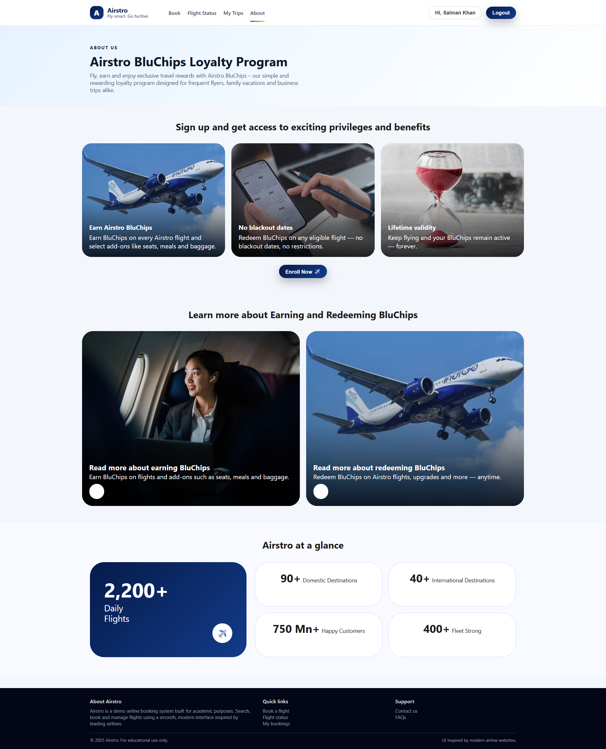
About Us Page

Slide 23
CONCLUSION
The Airstro – Online Flight Booking System provides a modern and efficient solution for managing airline bookings digitally. It eliminates the need for traditional offline ticket reservations and offers a user-friendly platform where users can easily search flights, book tickets and manage their bookings. The admin can efficiently maintain flight schedules, update information, and oversee bookings through a centralized dashboard. By implementing digital automation, transparency, and role-based access control, Airstro improves the overall passenger experience and simplifies administrative operations. the system has high potential to evolve into a complete and scalable online airline reservation platform.

Slide 24
THANK YOU

